Slide 1
Remote and Mobile Healthcare System for Home Care
Group 12- Mamun Hossain, Gobikah Balaruban, Aaditya Rajput, Manreet Kaur

Slide 2
Problem Identification
Due to the burden on healthcare facilities globally because of the COVID-19 pandemic:
dietary habits and physical habits were impacted
Less visits to doctors for checkups -> unable to monitor health status
While the remote healthcare system has been in use since 1960, its benefits started gaining limelight during the pandemic. The remote healthcare monitoring system also known as the remote patient monitoring(RPM) is beneficial for health care during pandemics as it can provide treatment and care to patients at their home.

Slide 3
Background
Remote healthcare systems are being used more frequently, as it helps with reducing disease transmission, less emergency visits from chronically ill patients and reducing hospital stay costs.
Enhanced accessibility is one of the critical advantages of remote Healthcare systems as doctors will access the patient’s data quickly .
With Internet of Things (IOT), physical devices are able to connect, communicate and share data, with the use of sensors and other technologies like cloud computing

Slide 4
Project Overview
Creating a portable device that will have four sensors , PPG, ECG , heart rate and oximeter connected to the patient .
The data collected from the diagnoses will be further calculated (eg. calculating waveforms) and will be done in real-time
The data will then be displayed to the user in a numerical or graphical format
This information will be sent and stored in a cloud server for users to view later

Slide 5
Stakeholder Requirements
The mobile medical monitoring system must be able to perform diagnostics and collect data for measures like ECG, BPM, PPG and blood oxygen
The system must be able to store the data from the checkup
The monitor system must display the results of a checkup in real-time

Slide 6
Engineering Requirements
The mobile Medical Monitoring System must be able to collect heart rate, and ECG at a sampling rate of 512,100 BPS, 9600 BPS respectively
The Backend handle all calculations of data ( waveforms, conversions, beats per minutes, averages)
The application must be able to store data from the sensors and provide real-time analysis of the accumulated data
If the Heart rate monitor detects an abnormal heart rate (below 55 BPM, above 120 BPM), an email should be sent to the patient.

Slide 7
Engineering Requirements Continued
5. The system should run on a reliable cloud server with sufficient RAM to allow quick response times.
6. The system should handle multiple requests (multiple diagnostics like heart rate, blood volumes) from the user at the same time.
7. The monitor system display must display the results of the diagnostics in a easy to understand way.
8. The system should store previous data up on a cloud database server which allows storage capacities up to 10GB.

Slide 8
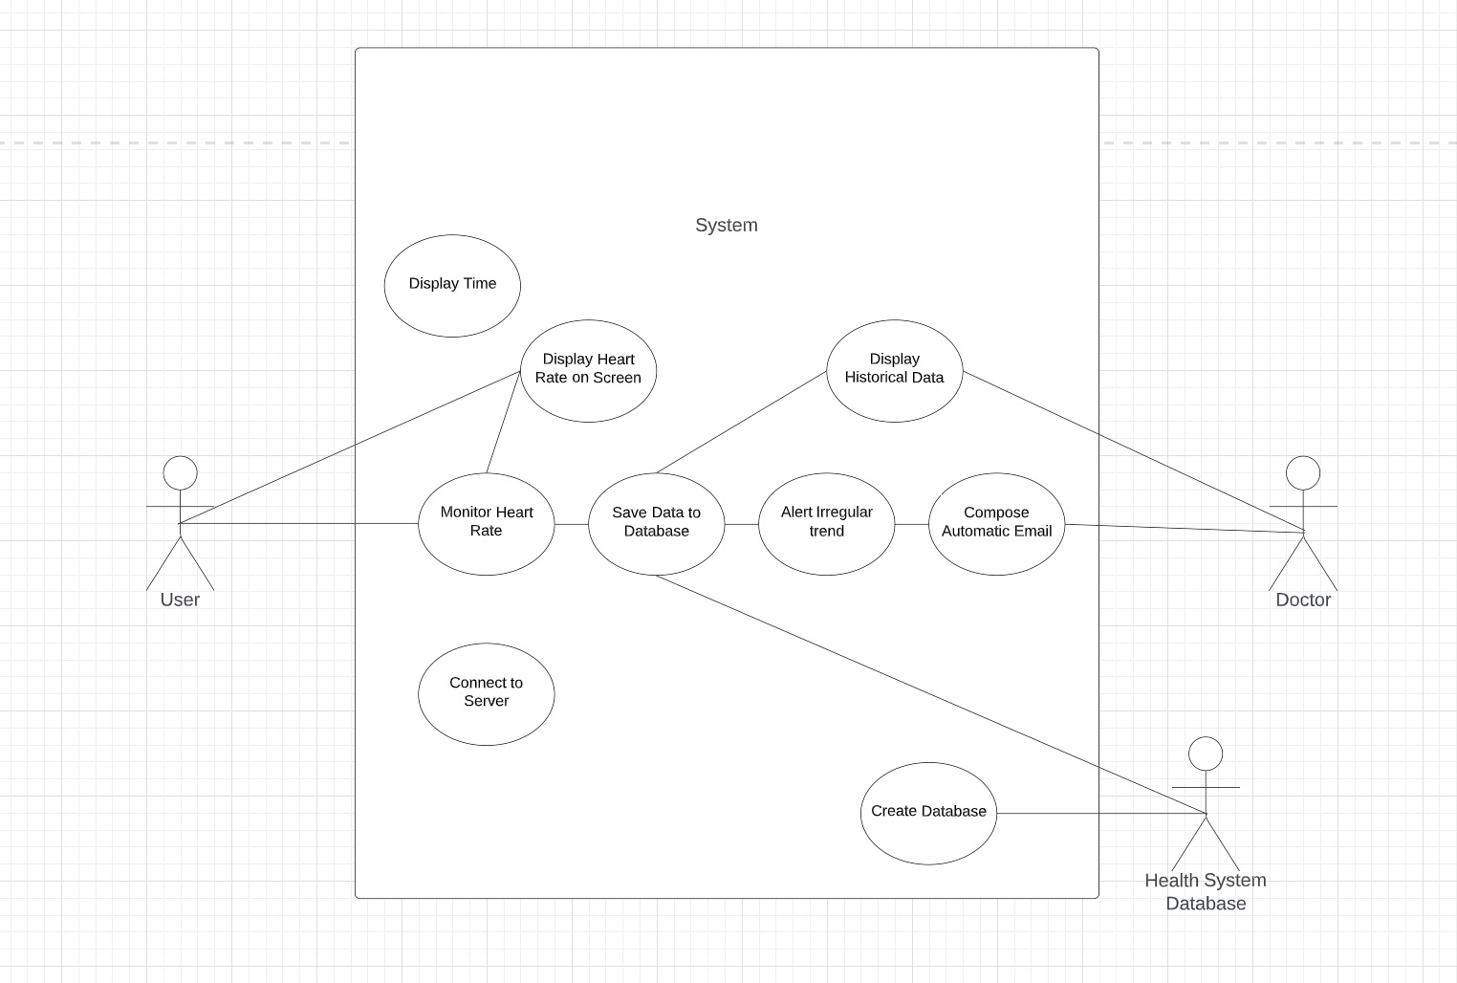
Use Case

Slide 9
Concept Generation
Developing a hardware system that interacts with software based system
Being able to read and store data from the sensors to the system
Being able to store the information received from a cloud server

Slide 10
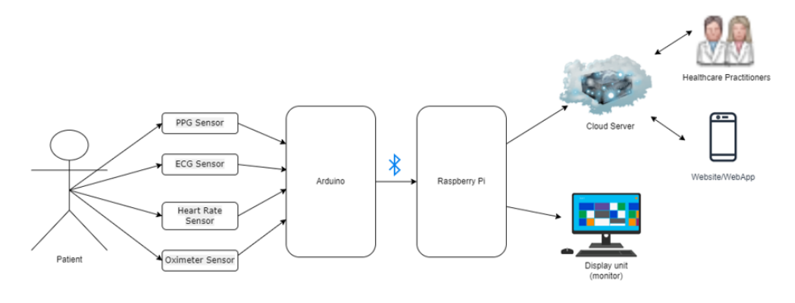
Concept Design
Notes:
Concept Design. Based on the concept generation, we created this overall system design diagram that showcases a patient getting monitored by the various sensors. The sensors are connected to the Arduino. In order for the Arduino to connect to the Raspberry Pi, a bluetooth module can be used. Afterwards, the raspberry pi sends the data to the cloud server and the display unit. The displays of the diagnostic are shown in the display unit for the user to view. The data is stored in the cloud server, which can later be accessed and retrieved by healthcare practitioners and/or the patients.

Slide 11
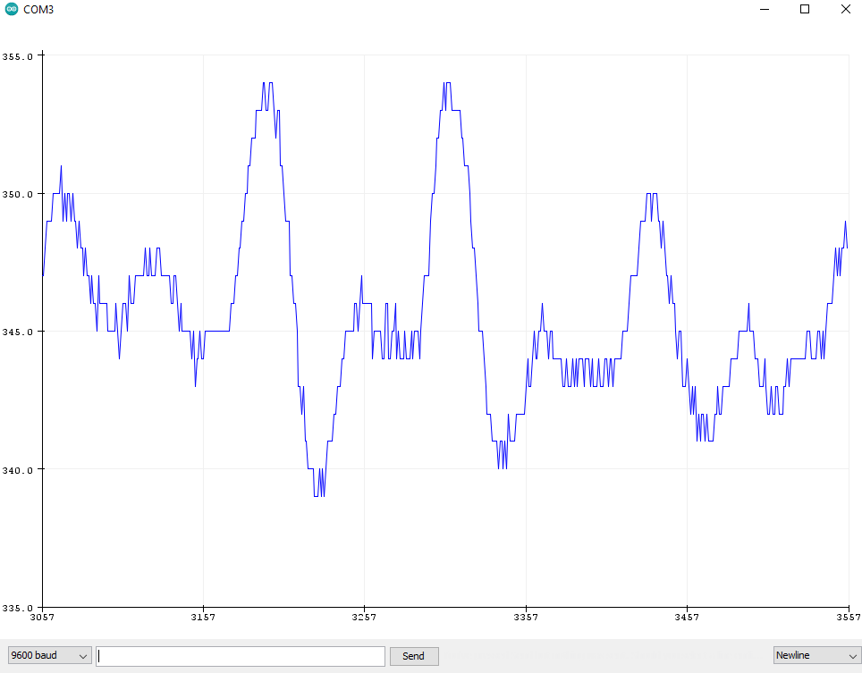
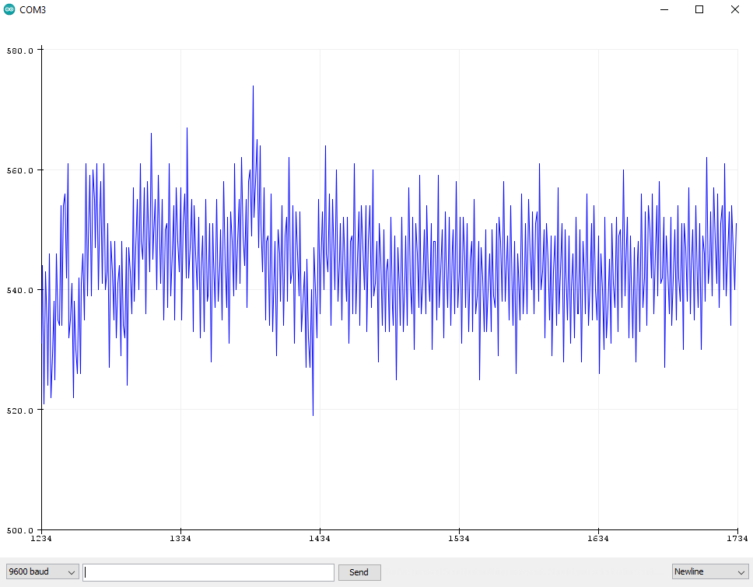
Prototype Screen Dumps
9600 bits per minute at 3.3V
9600 bits per minute at 5V

Slide 12
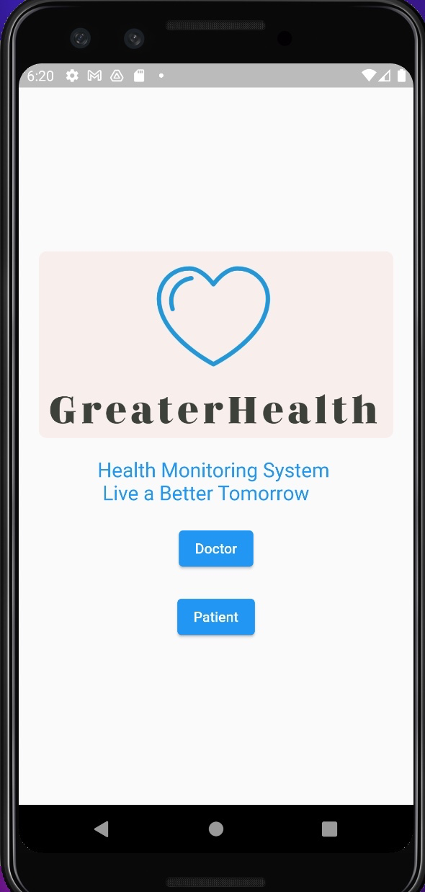
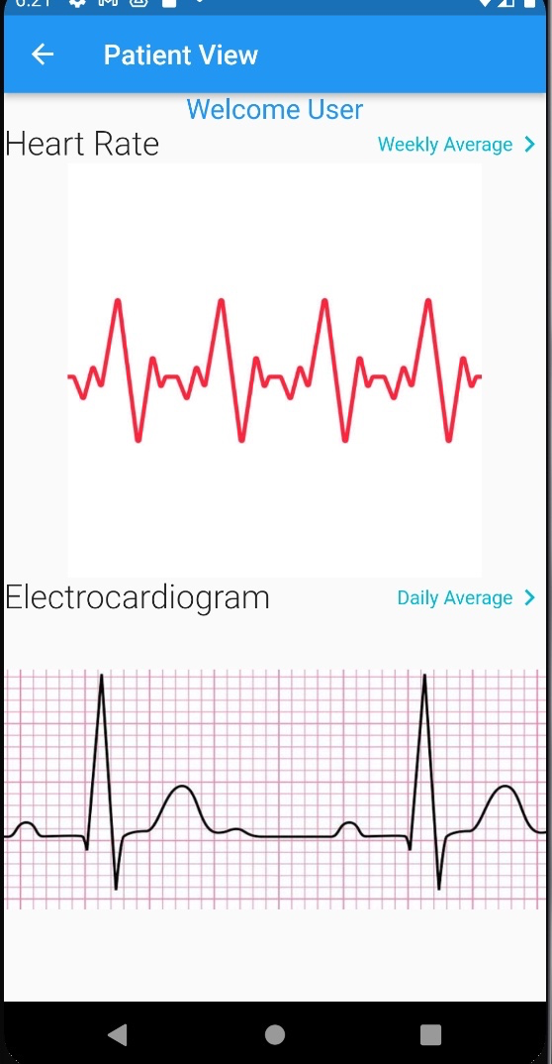
Prototype UI

Slide 13
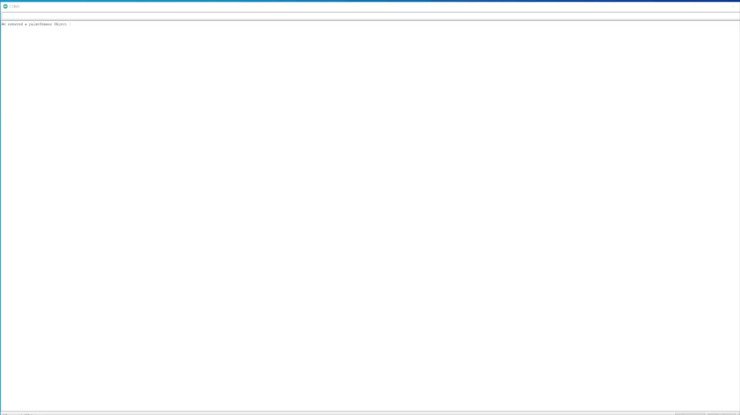
Prototype
Notes:
https://drive.google.com/file/d/1c8IOfqr-zhFr7tSKStJ-nQTIHBC-KiKl/view?usp=share_link

Slide 14
Challenges
Topic was finalized late and took a toll on the remaining time to work on the two reports
Implementing both Raspberry Pi and Arduino caused problems when creating our prototype
Connecting to the cloud requires more time to set up
Notes:
These are some of the challenges that we faced: one being the topic was finalized late and this had an effect on the remaining time to work on Report 1 and 2. Implementing both Raspberry Pi and Arduino together caused problems when we were creating our prototype and another challenge was connecting to the cloud, which requires more time to set up.

Slide 15
Conclusion and Future Plans
During the fall semester, we were able to
Properly identify our problem and create a problem statement
Define stakeholder requirements, engineering requirements, and use cases
Create a prototype with two of the proposed sensors: ECG and Heart Rate
Future Plans:
Implement the cloud server for the data to be stored to
Design a User Interface (UI) for the users
Integration and Unit Testing for testing components of the system
Acceptance and Performance Testing
Fully functional prototype
Notes:
To conclude, we were able to properly identify our problem and create a problem statement, define stakeholder requirements, engineering requirements, and use cases. We were able to create a prototype with an ECG and heart rate sensor. Our plans for the winter semester include implementing the cloud server, designing a UI, integration, unit, acceptance and performance testing, and to overall have a fully functional prototype with the capable components. And that concludes our presentation, thank you for listening

Slide 16
Thank You

